Slide 1
Auto Sense
Under Supervision Of:
Eng - Youssef Nofal Eng - Nour Hassan
18 - 11 - 2023

Slide 2
Table of contents
01
02
03
04
05
06
07
Introduction
Rplidar
ACC & NCC
AEB & LKA
Bootloader
Fota
Test Cases

Slide 3
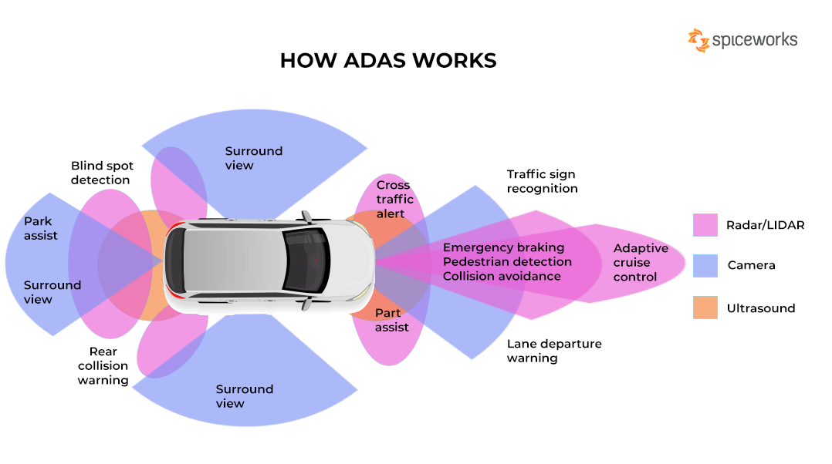
01
Introduction

Slide 4
Introduction
Introduction to Advanced Driver Assistance Systems (ADAS)
Advanced Driver Assistance Systems (ADAS) revolutionize vehicle safety and driving experiences. Utilizing sensors, cameras, and advanced algorithms, ADAS enhances safety through features like collision avoidance, adaptive cruise control, and parking assistance. These systems aim to reduce accidents, improve road safety, and lay the groundwork for future autonomous driving. As technology progresses, ADAS continues to evolve, contributing to a smarter and safer driving environment.

Slide 5
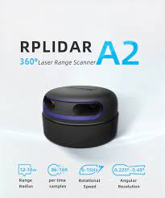
02
RPLIDAR

Slide 6
RPLIDAR
The RPLIDAR A2M8 is a compact and affordable Lidar sensor from Slamtec, ideal for robotics and drones. Using laser time-of-flight technology, it delivers accurate distance measurements. Notable for its 360-degree scanning capability, it provides a real-time, comprehensive view of the surroundings. With a lightweight design, it's easy to integrate into space-constrained robotic platforms, making it a popular choice for applications requiring precise environmental mapping and obstacle detection.

Slide 7
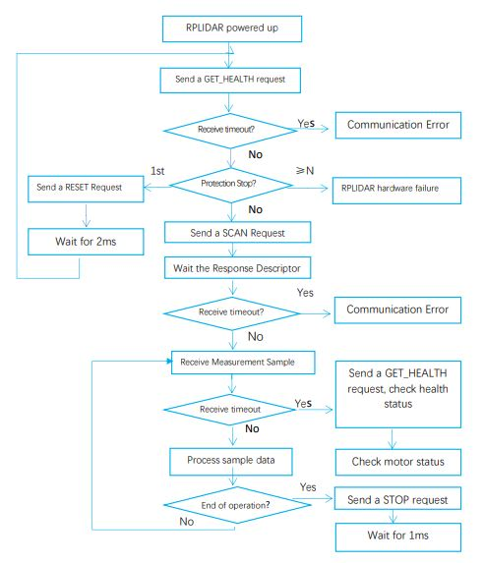
RPLIDAR Flow Chart

Slide 8
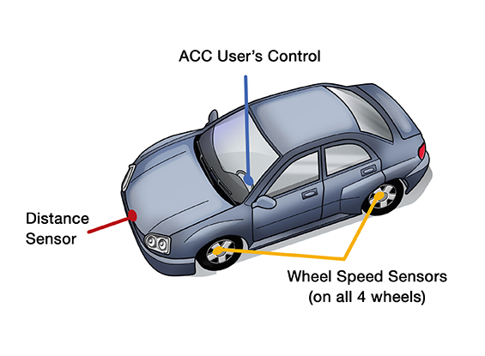
03
ACC & NCC

Slide 9
ACC & NCC
Adaptive Cruise Control (ACC)
Adaptive Cruise Control (ACC) is an advanced vehicle technology that enhances traditional cruise control by automatically adjusting the vehicle's speed to maintain a safe following distance from the vehicle ahead. Using sensors, such as radar or lidar, ACC can detect the speed of nearby vehicles and autonomously regulate acceleration and deceleration, providing a more dynamic and responsive driving experience. This technology improves overall driving comfort and safety by reducing the need for manual speed adjustments in varying traffic conditions.

Slide 10
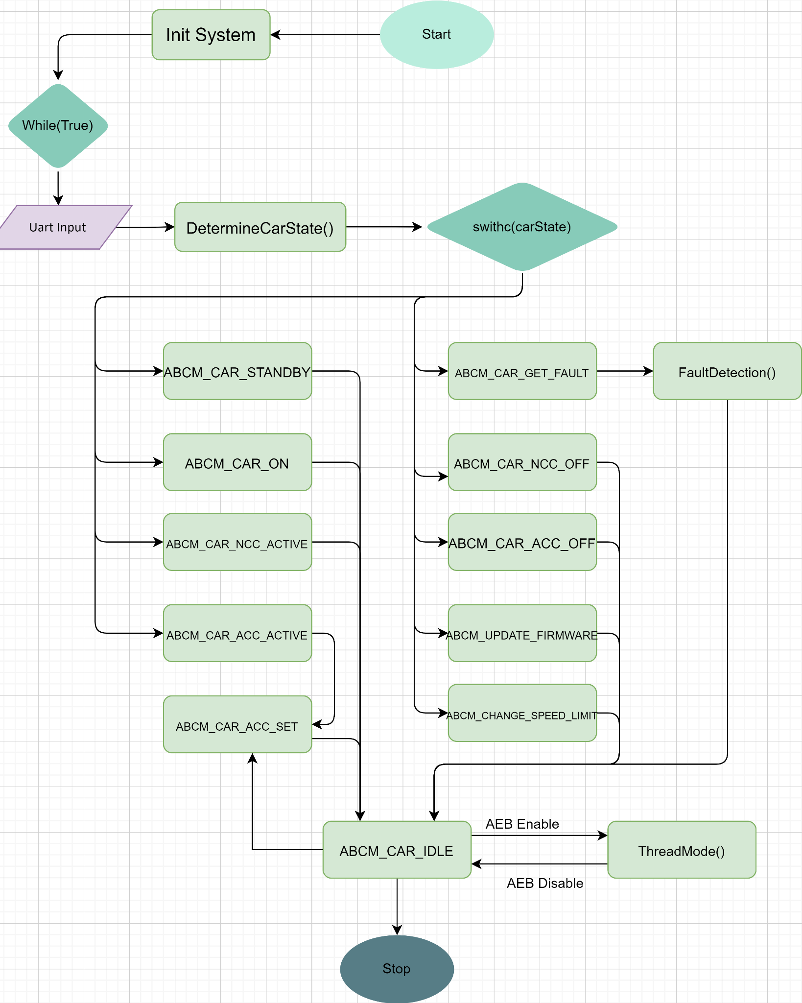
BCM Flow Chart

Slide 11
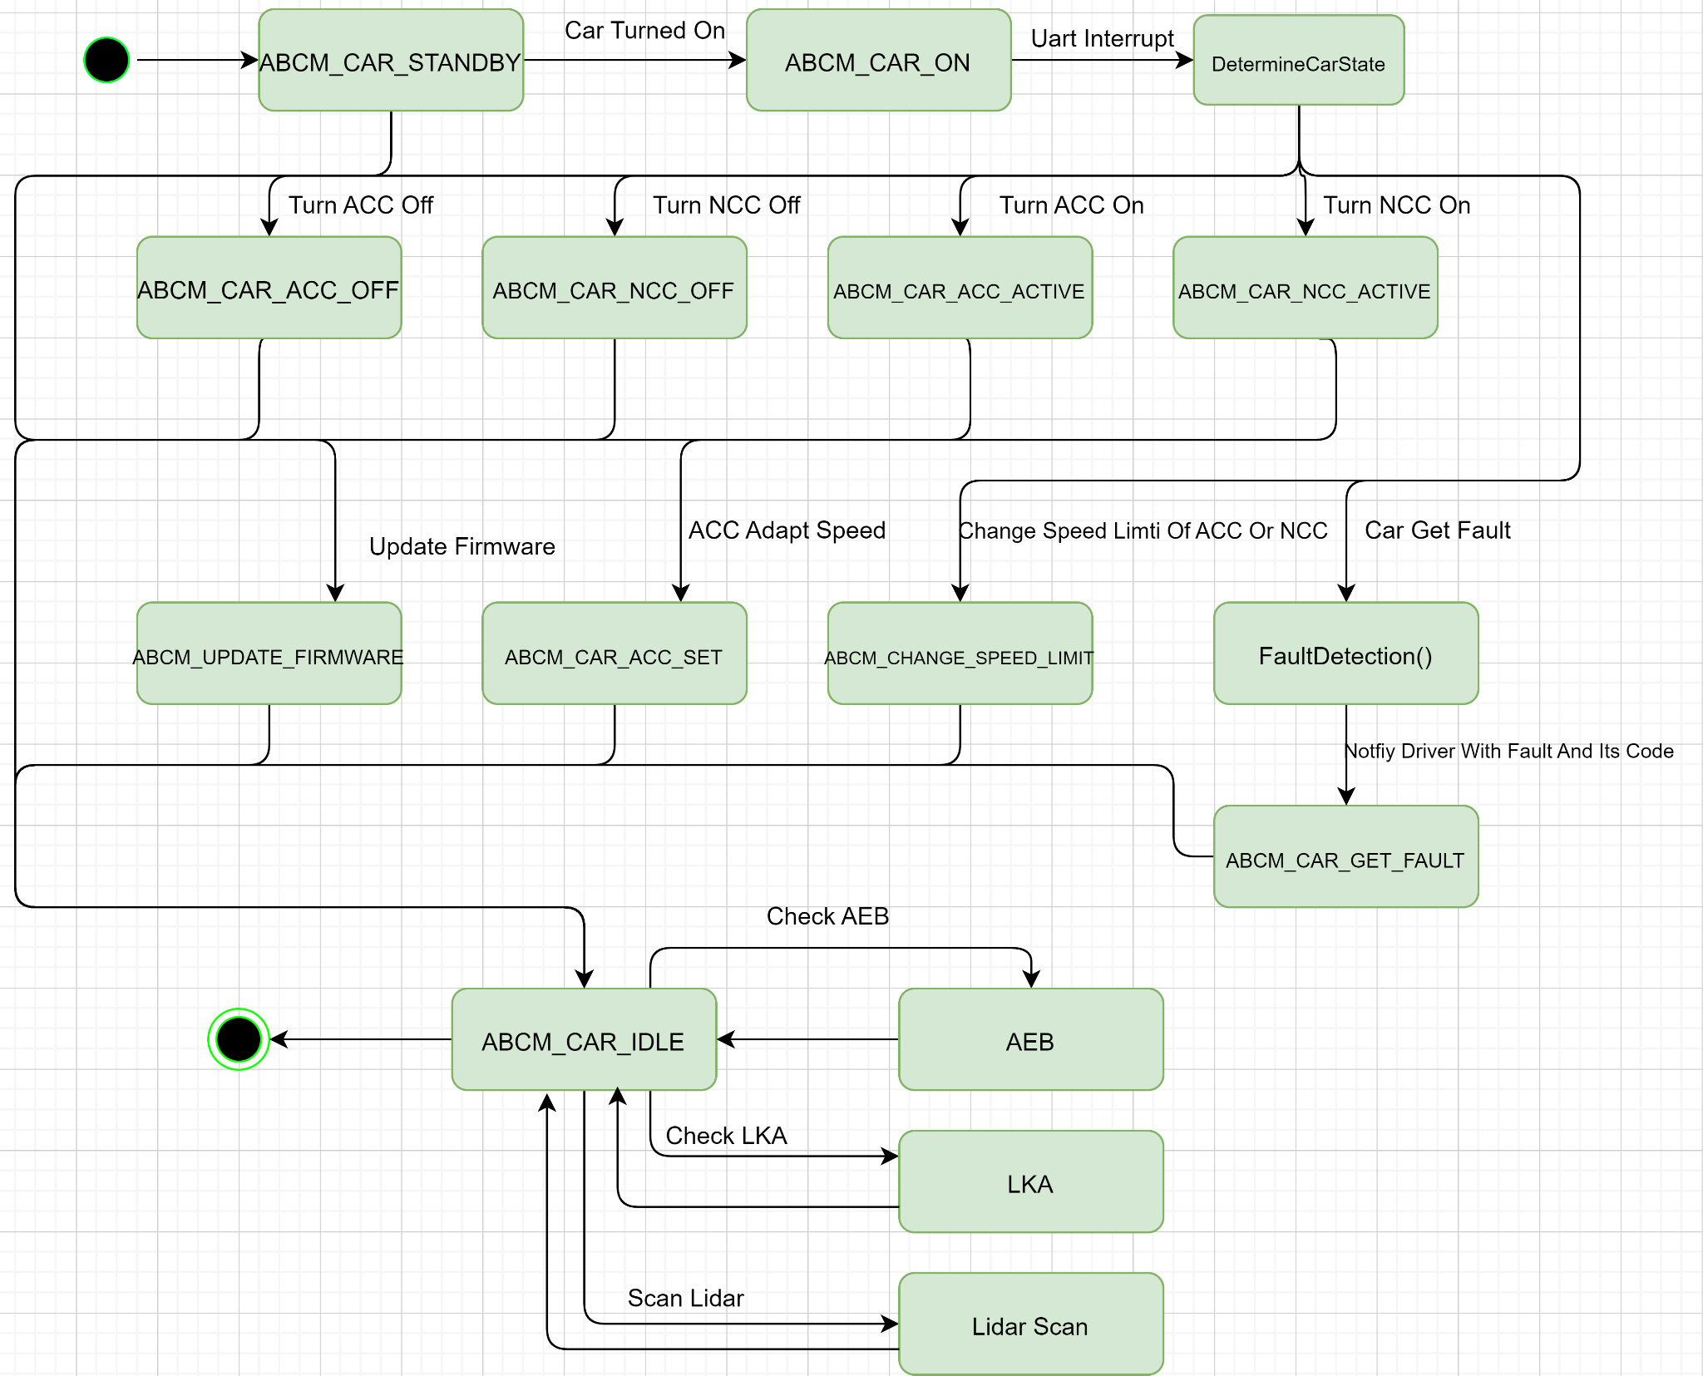
BCM State Machine

Slide 12
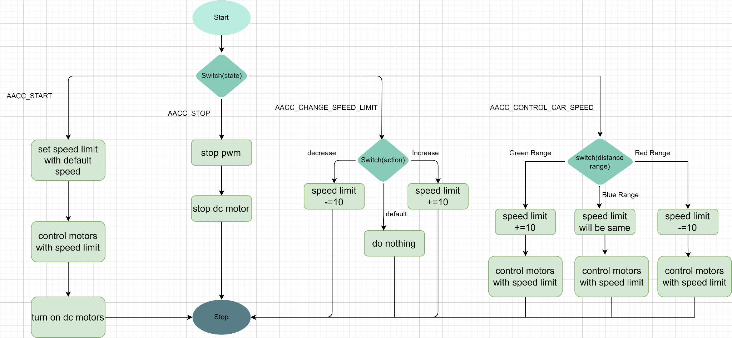
ACC Flow Chart

Slide 13
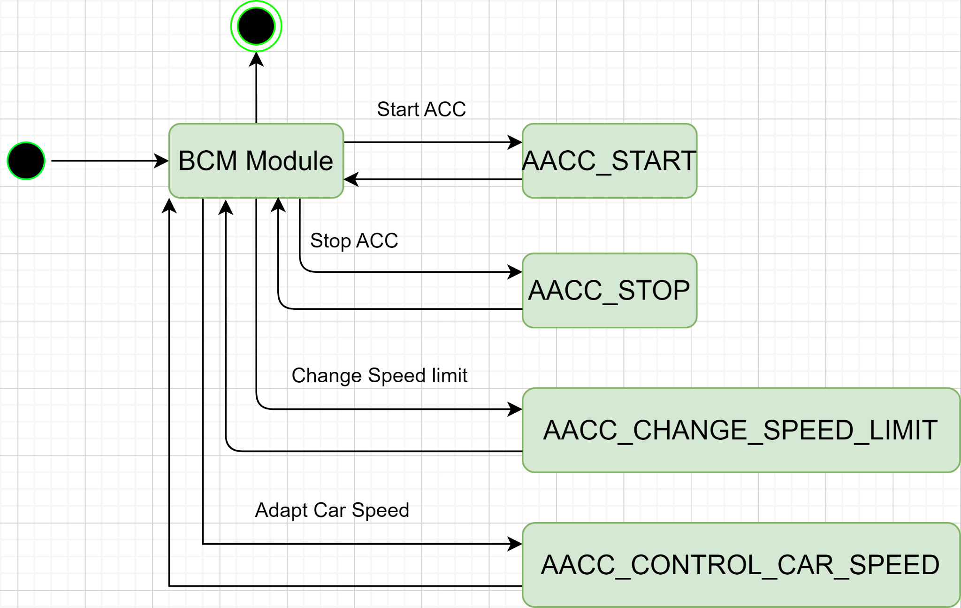
ACC State Machine

Slide 14
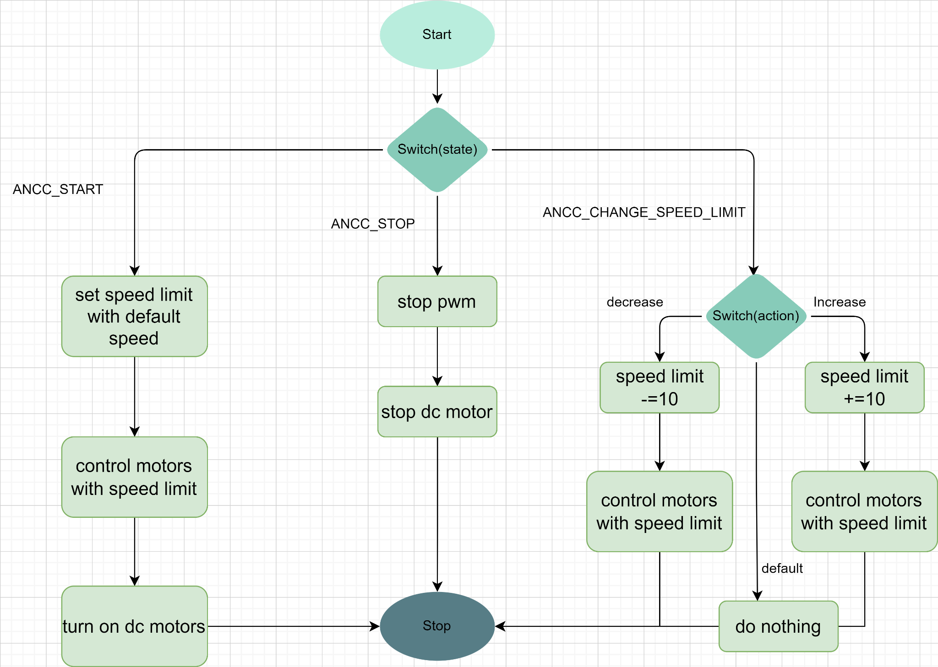
NCC Flow Chart

Slide 15
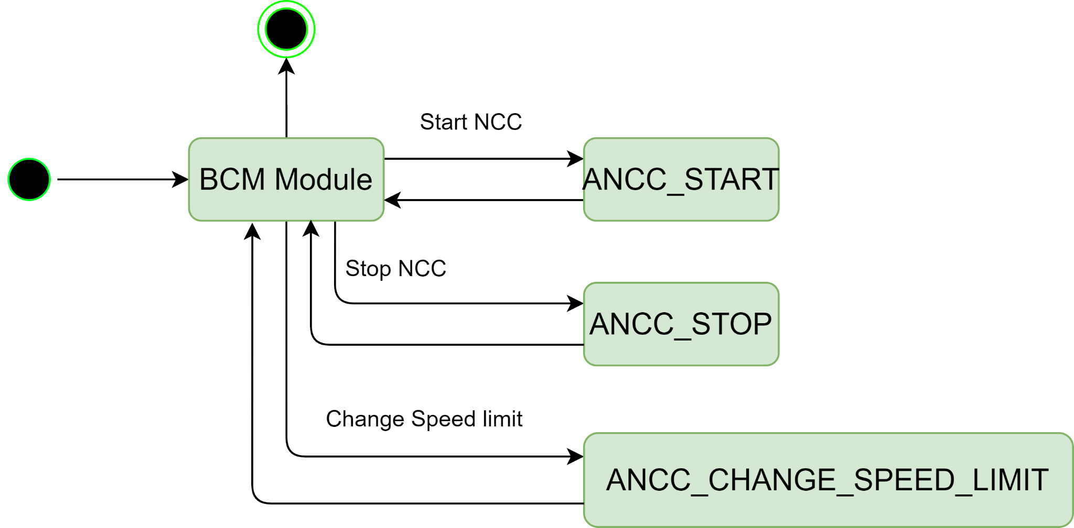
NCC State Machine

Slide 16
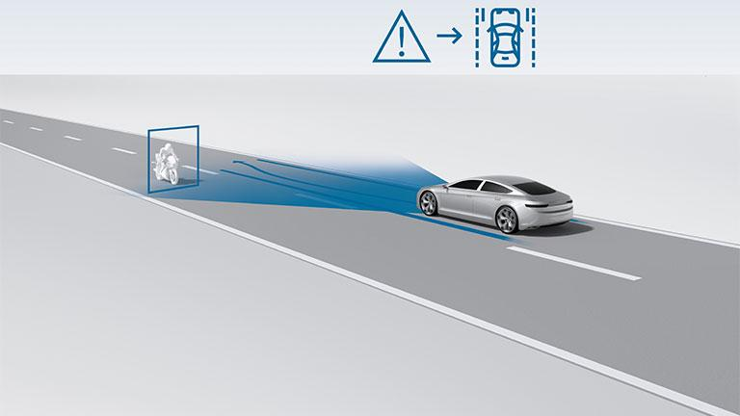
04
AEB & LKA

Slide 17
AEB & LKA
Lane Keeping Assistance (LKA)
LKA prevent unintended lane departure by providing alerts or gentle steering corrections, enhancing driving safety.
Automatic Emergency Braking (AEB)
AEB employs sensors to detect imminent collisions and automatically applies the brakes if the driver doesn't act, reducing the risk and severity of accidents.

Slide 18
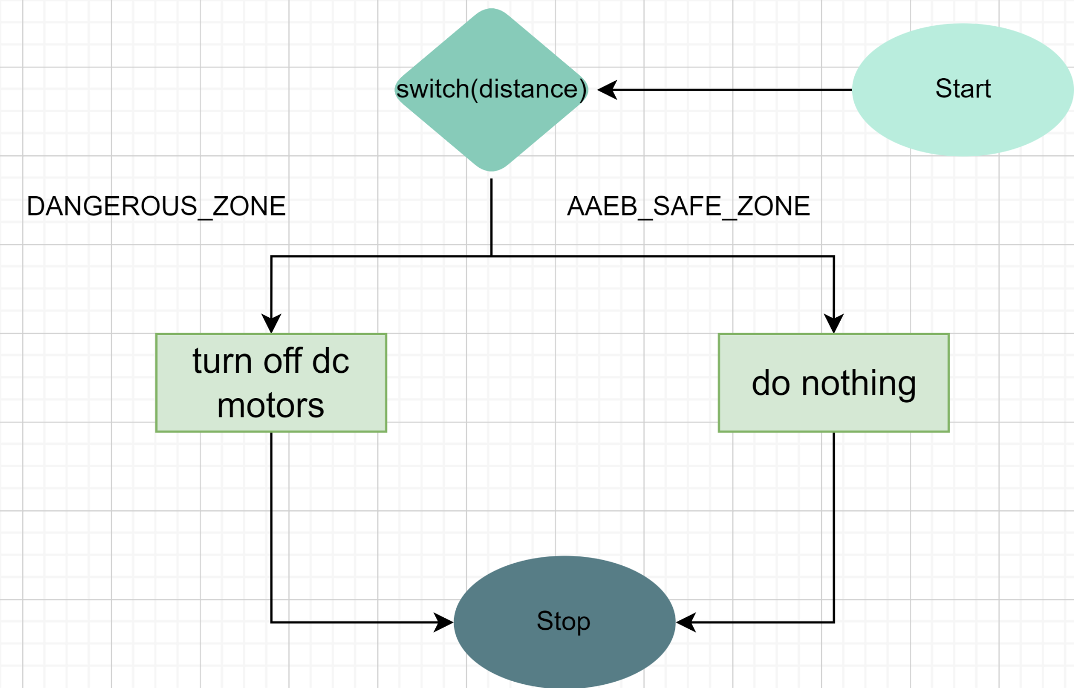
AEB Flow Chart

Slide 19
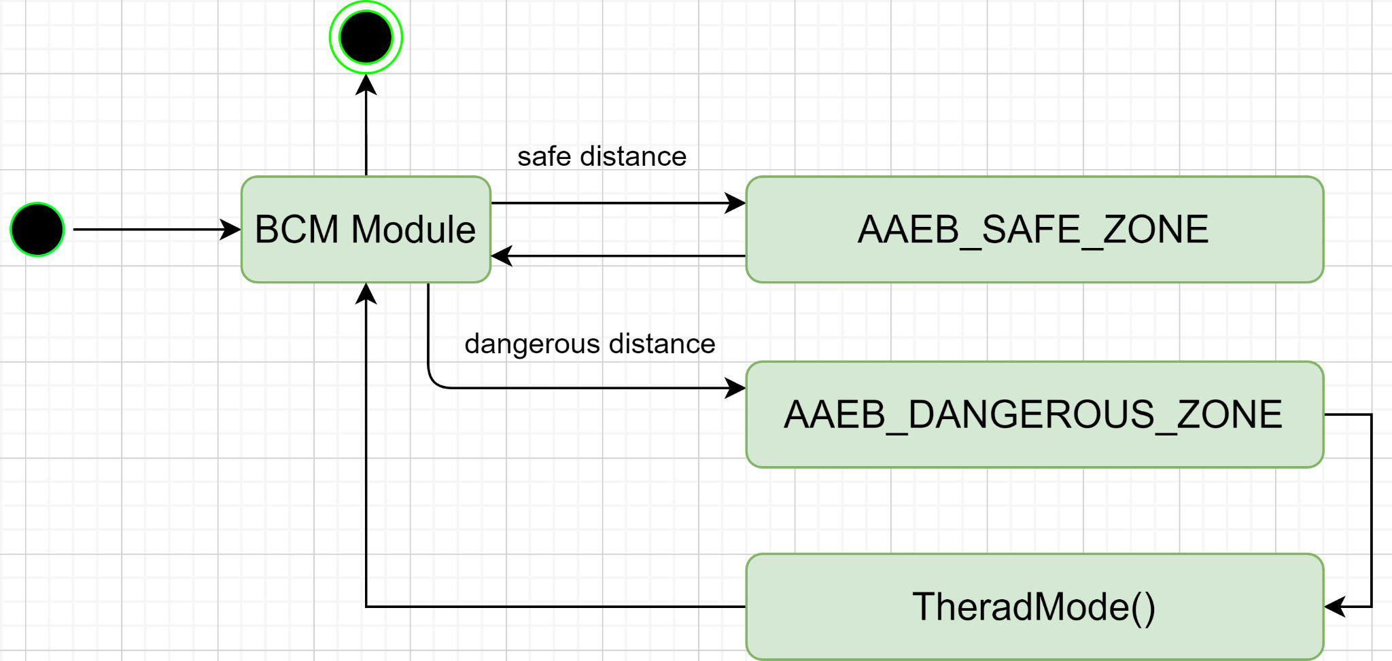
AEB State Machine

Slide 20
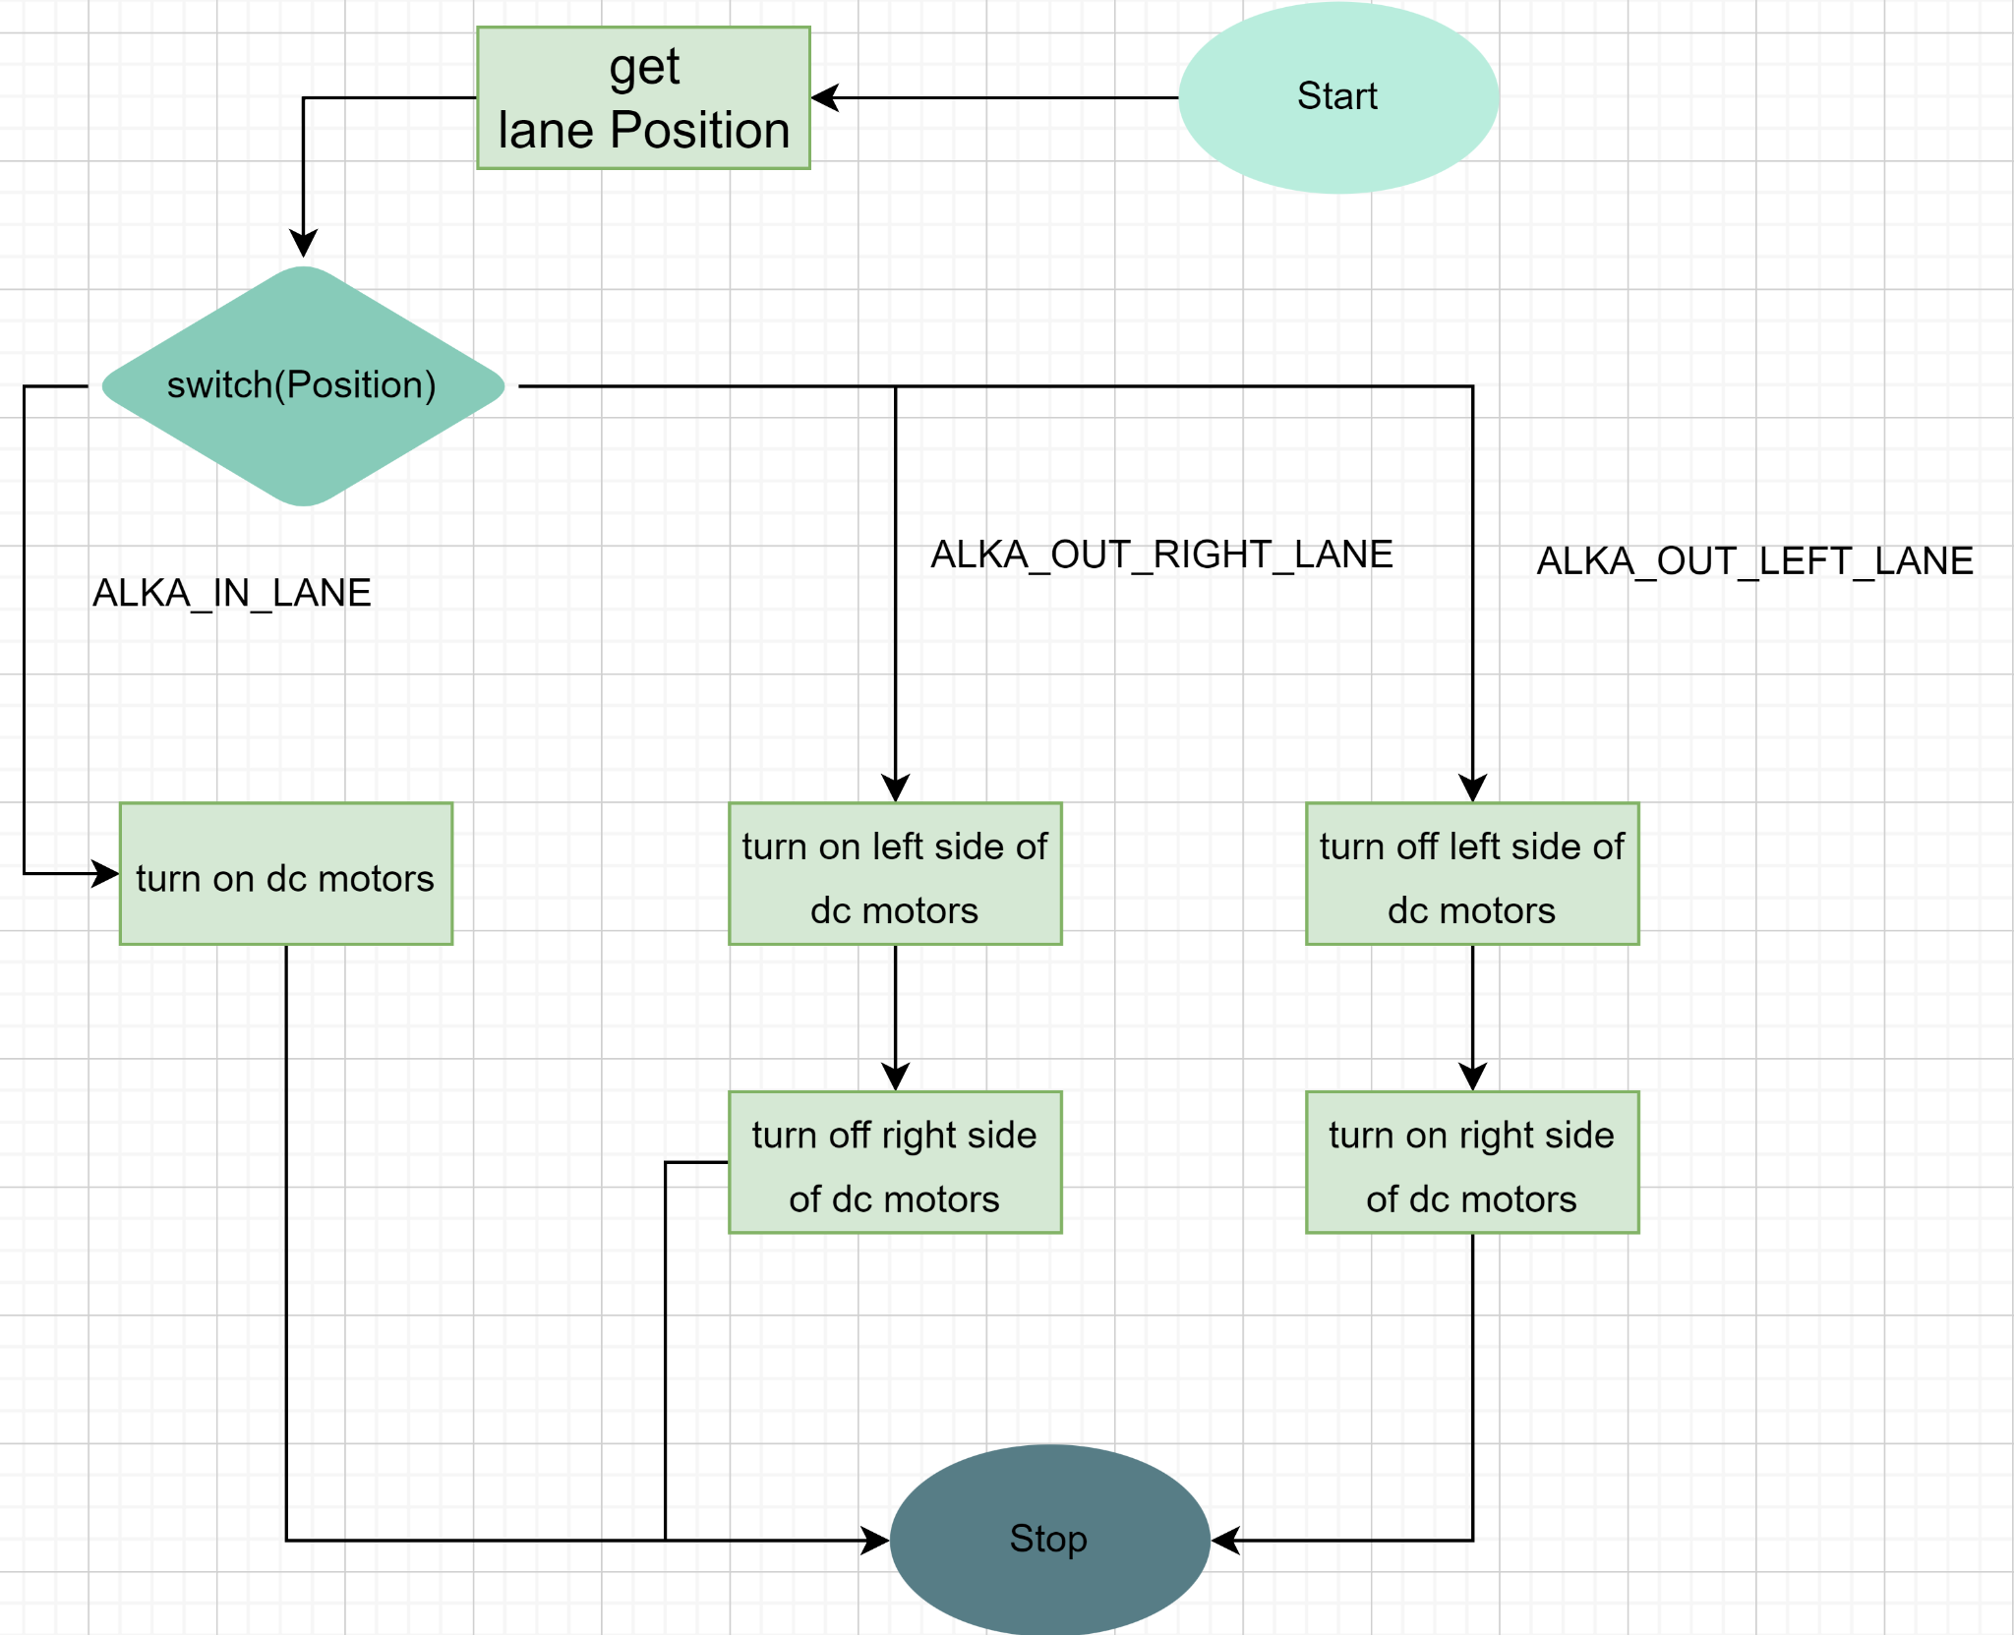
LKA Flow Chart

Slide 21
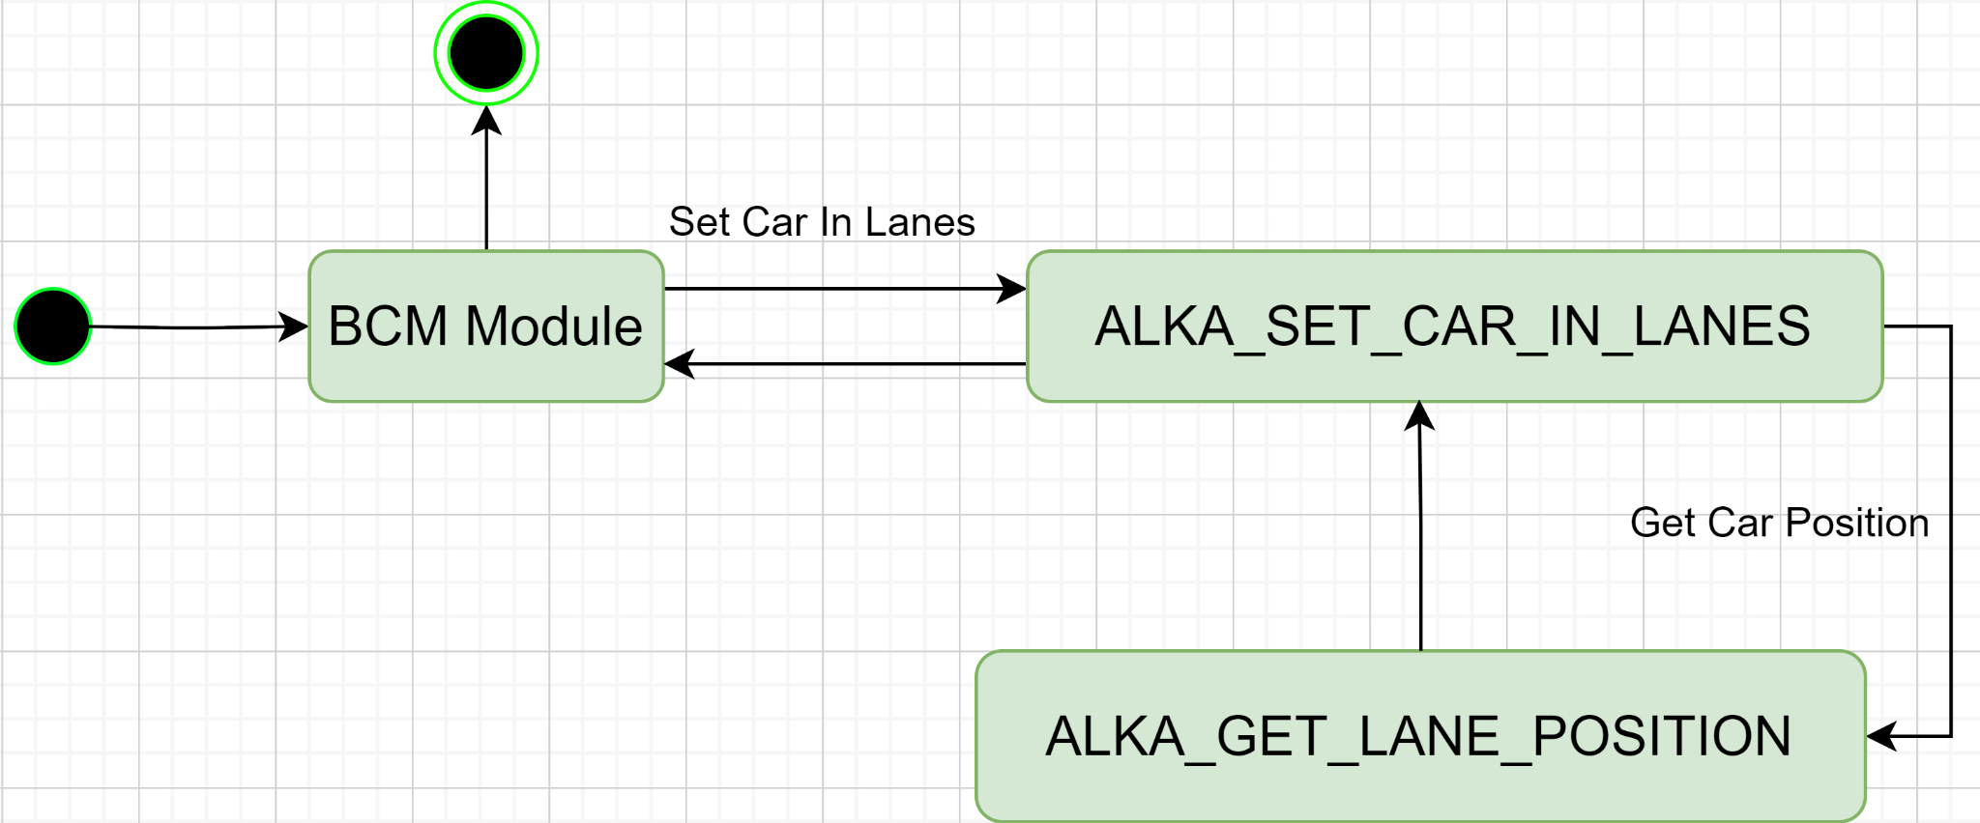
LKA State Machine

Slide 22
05
Bootloader

Slide 23
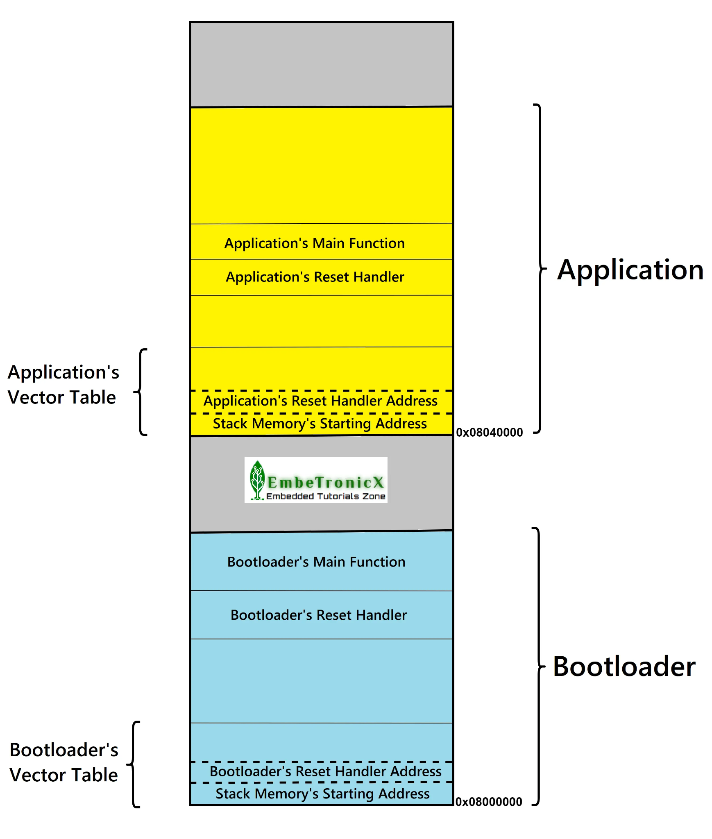
Bootloader
Overview
The STM32 Bootloader is a software tool used to program microcontrollers based on the STM32 family. It allows developers to upload and download code to the microcontroller, as well as configure various settings and options.
Functionality
•Upload and download code to the microcontroller
•Configure various settings and options, such as clock speed and memory allocation
•Monitor the status of the microcontroller during programming

Slide 24
06
Fota

Slide 25
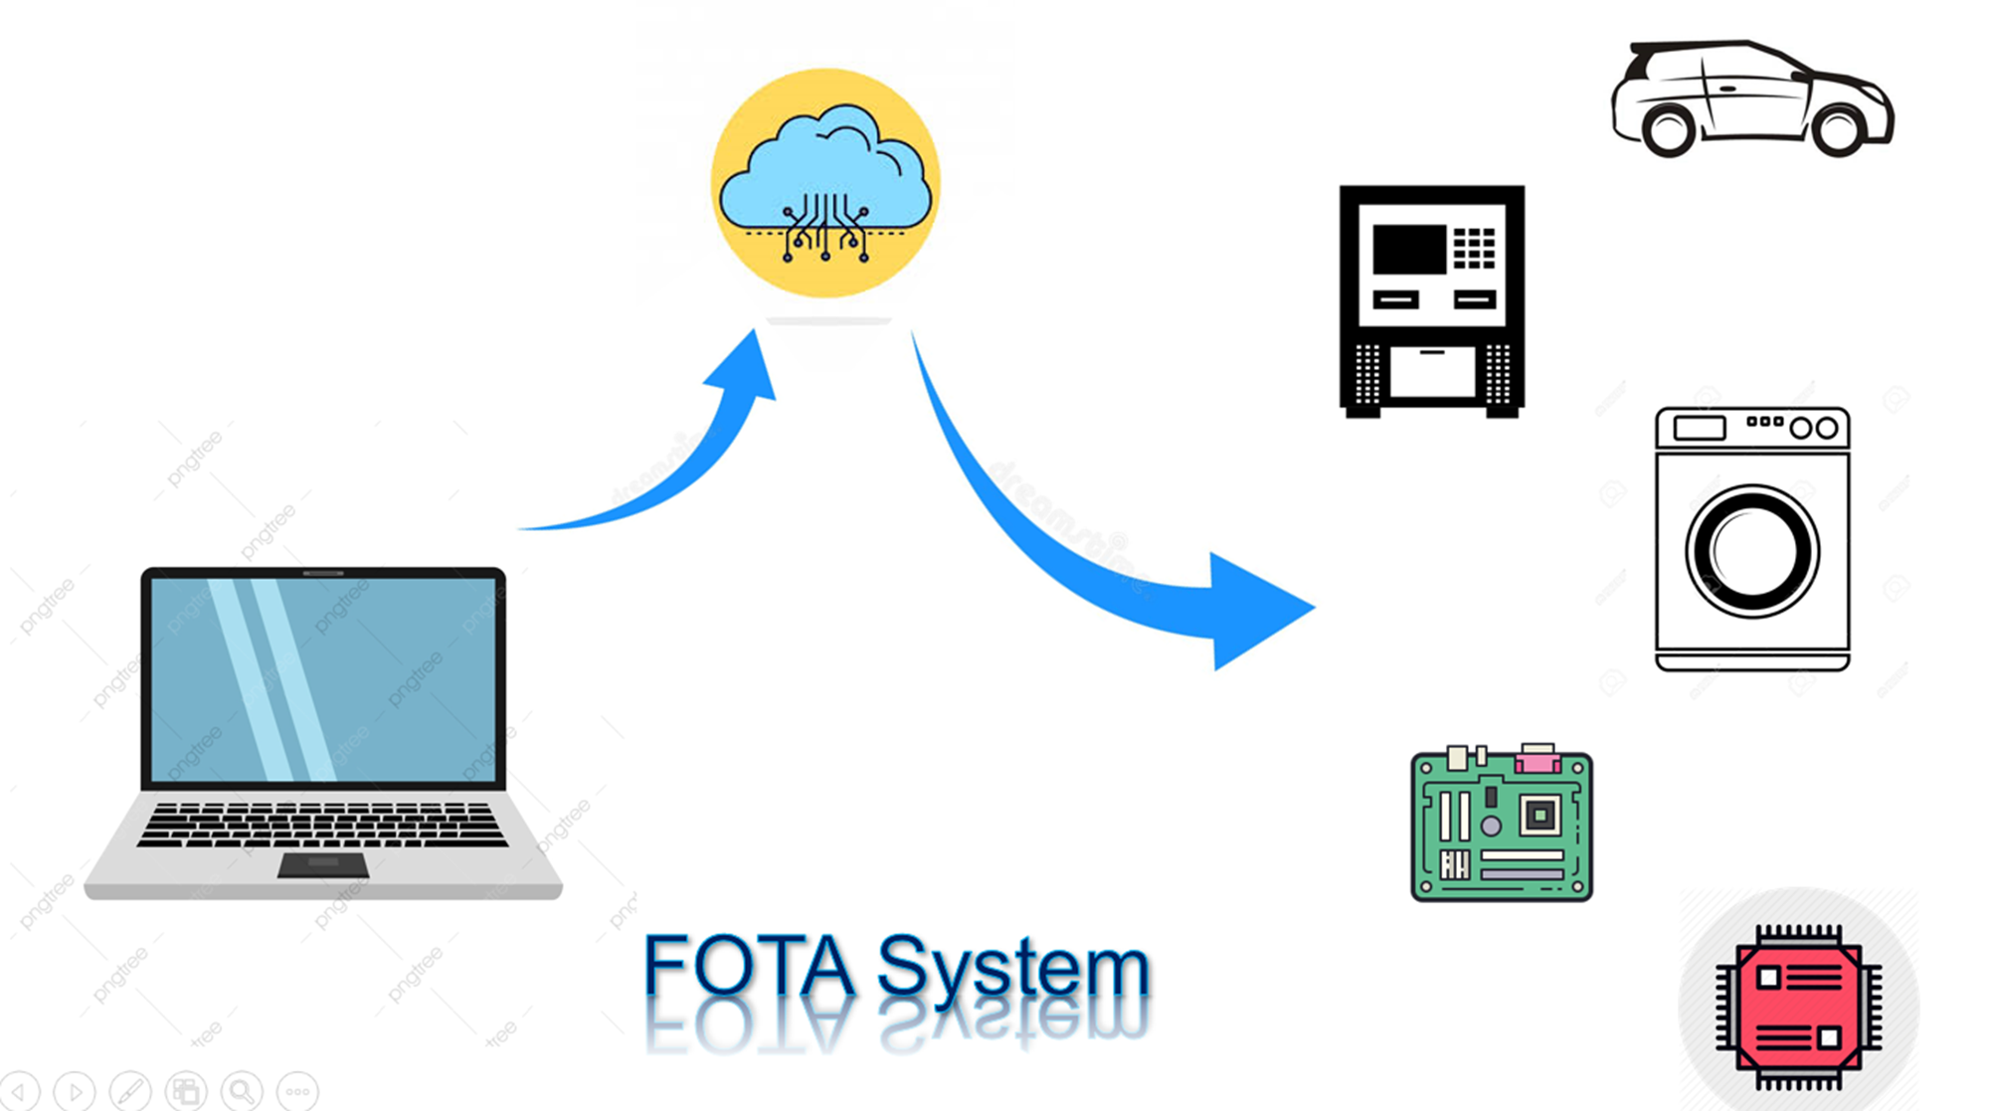
Fota

Slide 26
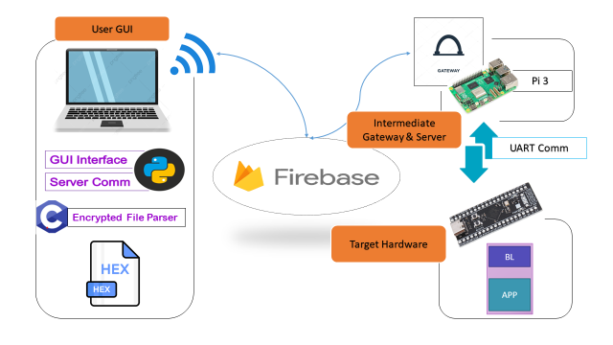

Slide 27
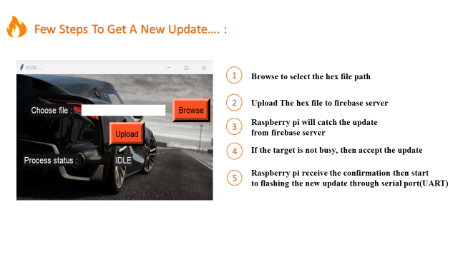

Slide 28

07
Test Cases

Slide 29
Adaptive Cruise Control (ACC) Test Cases
Name | Description | Expected Outcome | Actually outcome
Basic Functionality | Verify ACC engagement and disengagement | ACC engages and disengages smoothly without errors | Passed
Following Distance | Confirm ACC adjusts the following distance appropriately in traffic | ACC maintains a safe following distance in various traffic scenarios | Passed
Acceleration and Deceleration | Ensure ACC smoothly accelerates and decelerates | ACC adjusts speed appropriately in response to traffic conditions | Passed
Increase Speed Limit | Ensure ACC smoothly increase speed limit | ACC increase speed limit | Passed
Decrease Speed Limit | Ensure ACC smoothly decrease speed limit | ACC decrease speed limit | Passed

Slide 30
Lane Keeping Assistance (LKA) Test Cases
Name | Description | Expected Outcome | Actually outcome
Lane Detection | Verify LKA detects lane markings under different conditions | LKA accurately detects lane markings | Passed
Steering Correction | Confirm LKA makes appropriate steering corrections | LKA keeps the vehicle within the lane through steering adjustments | Passed
Steering Correction At Sharp curve | Confirm LKA makes appropriate steering corrections at sharp curve | LKA keeps the vehicle within the lane through steering adjustments | Passed
LKA Behave Correct With ACC | Confirm LKA makes appropriate steering corrections With Acc | LKA keeps the vehicle within the lane through steering adjustments | Passed
LKA Behave Correct With NCC | Confirm LKA makes appropriate steering corrections With Ncc | LKA keeps the vehicle within the lane through steering adjustments | Passed

Slide 31
Automatic Emergency Braking (AEB) Test Cases
Name | Description | Expected Outcome | Actually outcome
Collision Scenarios | Simulate various collision scenarios for AEB | AEB triggers appropriately in different collision scenarios | Passed
AEB Behave Correct With ACC | Verify integration between AEB and the ACC | AEB effectively engages the vehicle's braking system | Passed
AEB Behave Correct With NCC | Verify integration between AEB and the NCC | AEB effectively engages the vehicle's braking system | Passed

Slide 32
General Integration Test Cases
Name | Description | Expected Outcome | Actually outcome
System Integration | Check the overall integration of ACC, LKA, and AEB | ACC, LKA, and AEB systems work seamlessly together | Passed
User Interface | Verify the accuracy of the user interface | User interface displays accurate information about system status and alerts | Passed
Sensor Calibration | Ensure sensors are calibrated correctly | Sensors provide accurate detection and response | Passed

Slide 33
Thanks!
Do you have any questions?

